Slide 1
FCB unit V

Slide 2
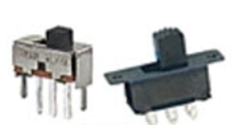
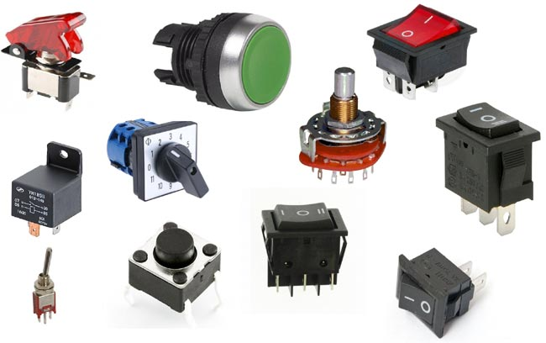

Molecular Switch
Common examples of switches around us.
A molecular switch is a molecule that can be reversibly shifted between two or more stable states with the help of stimulus.
Factors stimulating switching process: Ph, Light, Temperature, presence of ions, electricity, other heavy metal ions.

Slide 3
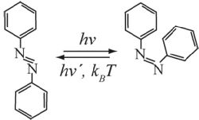

Examples of molecular switch
Acidochromic molecular switches: Ph Indicators and plants like rose, cornflowers.
Photochromic molecular switches: works with specific wavelength of light. Example Biotin or Vitamin B.
Nanoparticle Switches: Au, Ag, Cu, Ni, Cr all nanoparticle posses this particular switch
Cis-trans isomerization of azobenzene exposed to heating and light.
All these are gold nano particles under
Different wavelength of light.

Slide 4
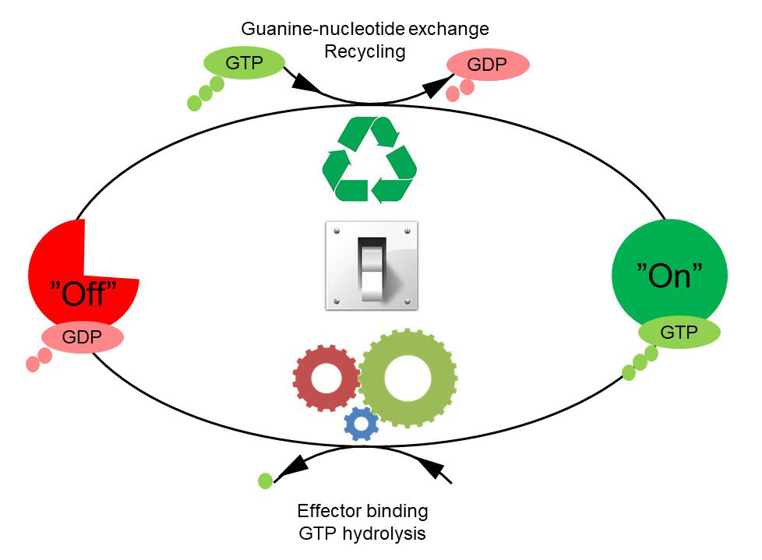
Mechanism of molecular switch
Example of GTPase mediated molecular switch.
In bacterial protein translation, GTPase enzyme
Cycles between on and off state post binding with
GTP molecule.

Slide 5
Flux balance analysis
Mathematical analysis of flux associated with biochemical reactions inside a cell.
A quick revision of the law of mass action?
How to represent metabolic networks:
• Stoichiometric coefficients
• The stoichiometric matrix
• System equations

Slide 6



The Law of Mass Action
The reaction rate is proportional to the probability of a collision of the reactants.
This probability is in turn proportional to the concentration of reactants, to the power of the molecularity: e.g. the number in which they enter the specific reaction.
A more general formula for substrate concentrations Si, and product
concentrations Pj is:

Slide 7
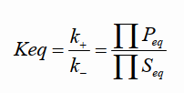
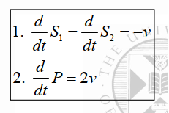
Equilibrium constrains
The equilibrium constant Keq characterizes the ratio of substrate and product concentrations in equilibrium (Seq and Peq), that is, the state with equal forward and backward rates.
The dynamics of the concentrations can be described by Ordinary Differential Equations (ODE), e.g. for the S1+S2→ 2P reaction:

Slide 8
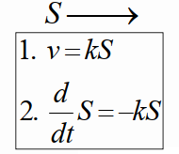
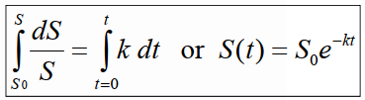
Laws of mass action for substrate decay
The kinetics of a simple decay (molecular destruction) such as:
Integration of this ODE from time t = 0 with the initial concentration S0 to an arbitrary time t with concentration S(t) yields the temporal expression:

Slide 9



Stoichiometric coefficients
Stoichiometric coefficients denote the proportion or substrates and products involved in a reaction.
The stoichiometric coefficients of S1 S2 and P are -1, -1, and 2.
ODE equation will be.
For a metabolic network consisting of m substances and r reactions, the systems dynamics is described by systems equations

Slide 10


Stoichiometric Matrix
Example 1
A → B
A + B → C
B + C → 2 A
Example 2
A → B
A + E → 2 C
B + C → D + E
2 E + C → 2 A + B
$$\begin{matrix}j_{1} & & j_{2} & j_{4}\end{matrix} \\ \left[\begin{matrix}−1 & & −1 & 2 \\ 1 & & −1 & −1 \\ 0 & & 1 & −1\end{matrix}\right]\begin{matrix}A \\ B \\ C\end{matrix}$$
$$\begin{matrix}j_{1} & j_{2} & j_{3} & j_{4}\end{matrix} \\ \left[\begin{matrix}\text{−1} & \text{−1} & 0 & 2 \\ 1 & 0 & \text{−1} & 1 \\ 0 & 2 & \text{−1} & \text{−1} \\ 0 & 0 & 1 & 0 \\ 0 & \text{−1} & 1 & \text{−2}\end{matrix}\right]\begin{matrix}A \\ B \\ C \\ D \\ E\end{matrix}$$

Slide 11
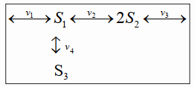
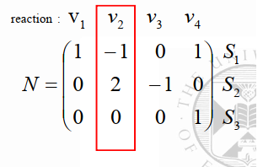
Stoichiometric Matrix
Example of a network

Slide 12

Flux analysis
Metabolic network consist of three elements:
S vector or Stoichiometric matrix
V vector or reaction velocities
P vector or parameter vector or known metabolites.
For a metabolic network that contains m metabolites and n metabolic fluxes, all the transient material balances can be represented by a single matrix equation:
where X is an m dimensional vector of metabolite amounts per cell, v is the vector of n metabolic fluxes, S is the stoichiometric m × n matrix, and b is the vector of known metabolic demands.

Slide 13


A simple network
Linear Transformation
e₁
v₁
e₂
A
v₃
B
$$\frac{dx}{dt}=S∗v$$
v₂
v₄
C
Stoichiometric Matrix
e₃
Linear Differential Equations
Dynamic Mass Balance (Steady State)
$$0=S∗v$$
Note: More unknown variables than equations,
thus no unique solutions! Need constraints!

Slide 14
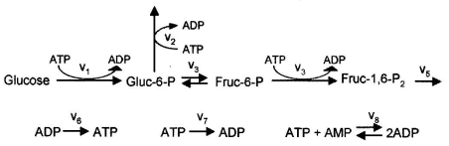
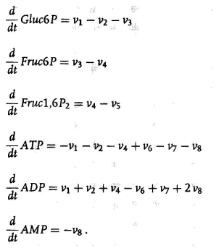
Detailed biological example

Slide 15

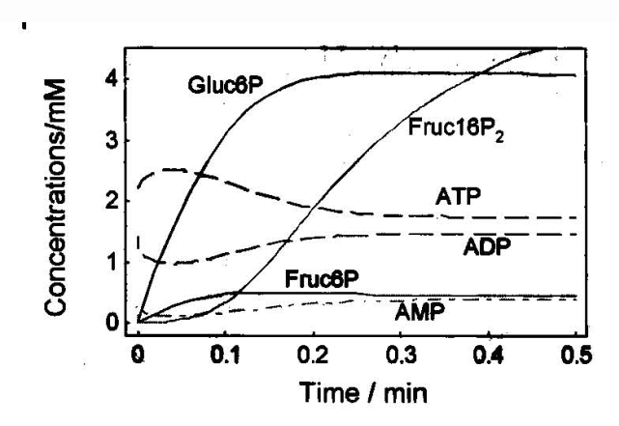
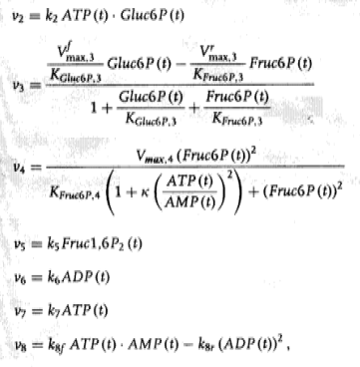
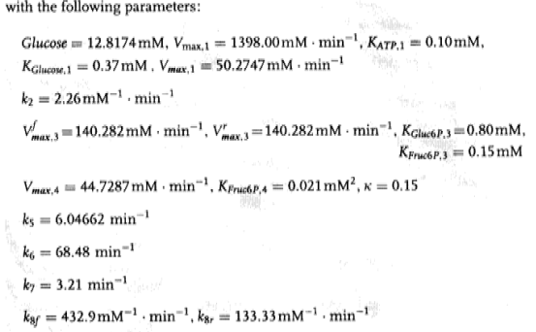
Glycolysis FBA example

Slide 16
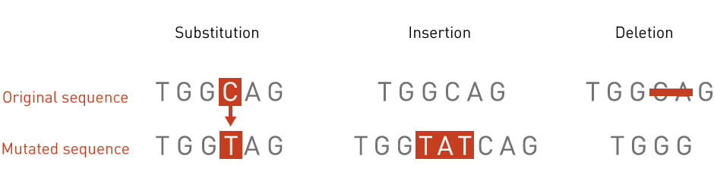
Mutational studies in a population

Slide 17
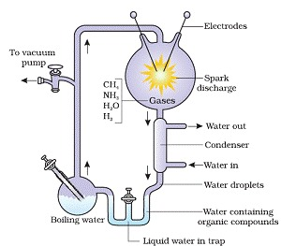
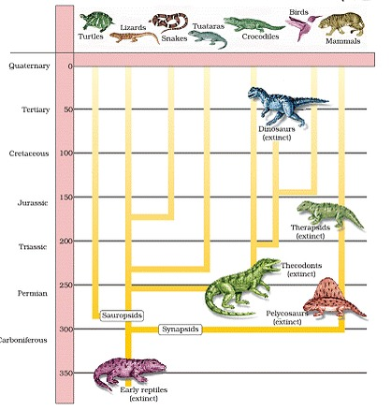
Background information: From your Textbook
Brief Account of evolution
About 2k mya first cellular form of life appeared.
Multi-cellularity came around 500 mya.
Jawless fish evolved around 350 mya.
Organisms started to invade from water to land. First amphibian came to existence.
Later, these amphibians evolved into reptiles. They lay shelled eggs. Then reptiles of different shapes and sizes dominated on earth.
Some of the reptiles evolved into birds and later some of them to mammals. Mammals were viviparous and more intelligent in sensing and avoiding danger.
Urey and miller experiment
Evolution of mammals from reptiles
Image and text source: NCERT XII Biology textbook

Slide 18
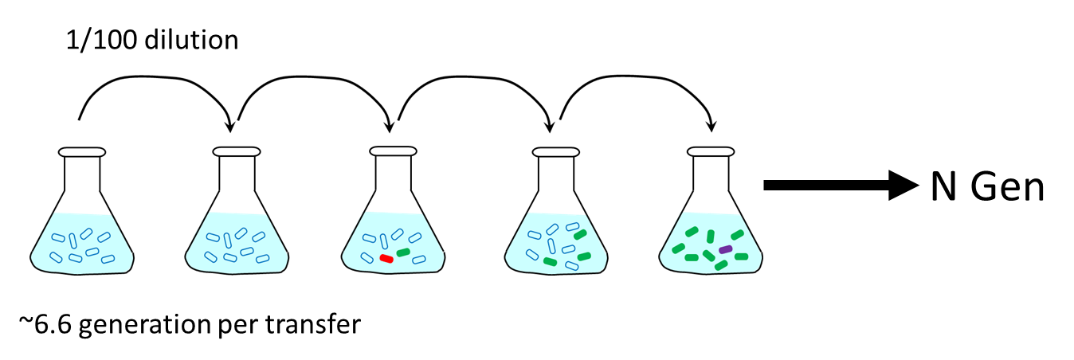
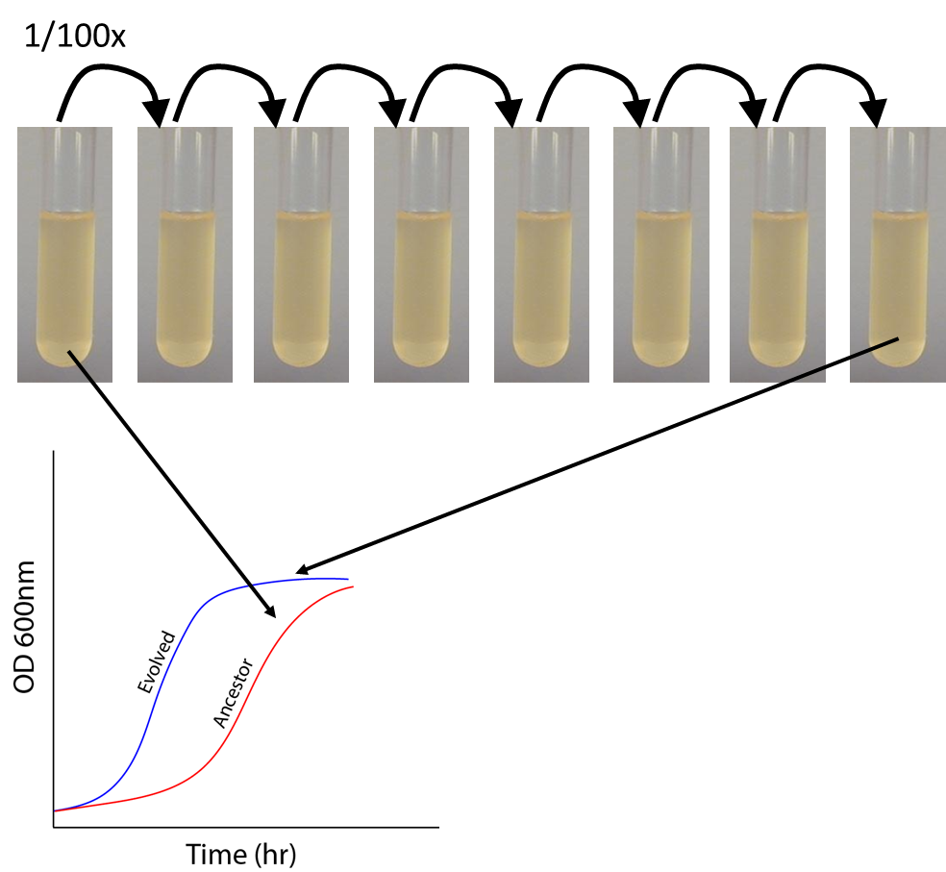
Evolutionary experiments: A glance

Slide 19
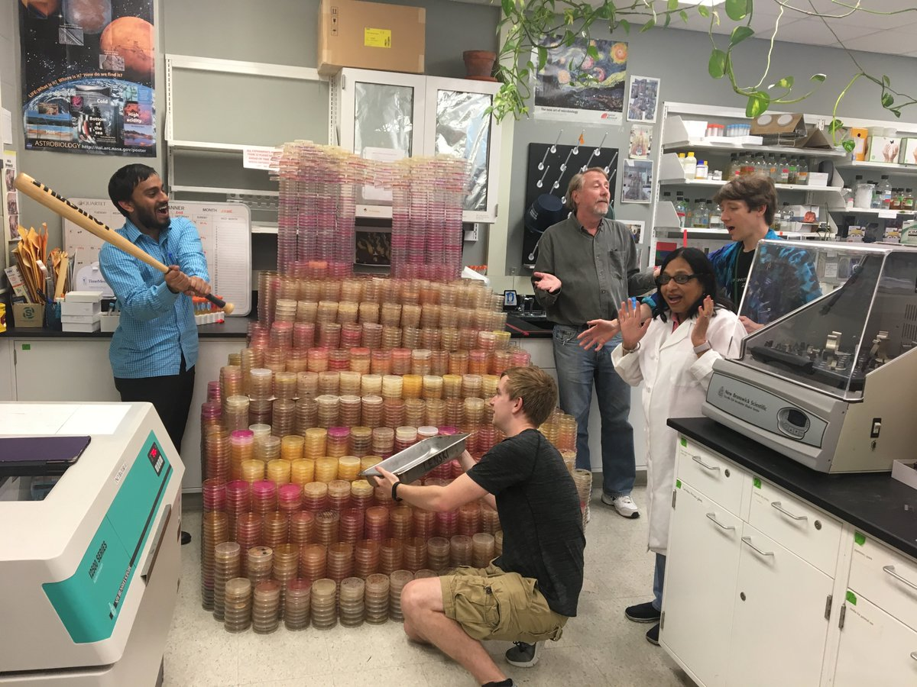
Can we observe evolution in lab?
Rechard Lenski: Michigan S.U.
Features of LTEE
12 identical populations of E. coli bacteria since 24 February 1988.
Evolution reached the milestone of 50,000 generations in February 2010.
A pattern of rapid increase in relative fitness during early generations, with this increase decelerating over time observed.
By 20,000 generations the populations show approx. 70% higher growth rate.
six have so far been reported to have hypermutation.
Increase in cell size concurrent with a decline in maximum population density.
Reported antagonistic pleiotropy in most of the strains.
Evolution of cit+ strain.
Long term evolution experiment on E. coli.
Image source: Lenski’s twitter account

